Slide 1
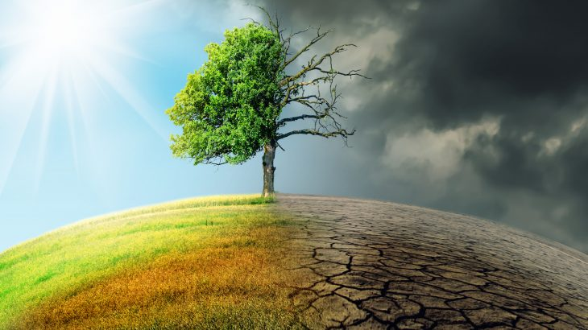
Climate change

Slide 2
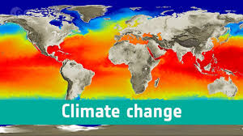
What is climate change?
Climate change is a change in Earth's climate. This could be a change in Earth's usual temperature.

Slide 3
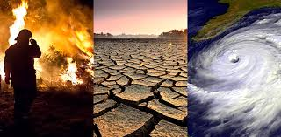
What is climate change?
Climate change is also a change in Earth's climate. This could be a change in Earth's usual temperature.

Slide 4
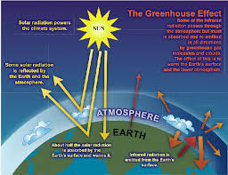
What produces climate to change?

Slide 5
What produces climate to change?
Many things can cause climate to change.
Earth's distance from the sun can change.
The sun can send out more or less energy.
Oceans can change.
When a volcano erupts, it can change our climate.
Most scientists say that humans can change climate too.
People drive cars.
People heat and cool their houses. People cook food.
Burning coal, oil and gas.
Burning these things puts gases into the air. The gases cause the air to heat up. This can change the climate of a place. It also can change Earth's climate.

Slide 6
Watch the video and answer the following questions.
What are alternatives to prevent climate change named in the video?
How many time did you listen the word «if»?

Slide 7
Create sentences with the alternatives named in the video
Create sentences with the alternatives named in the video using the first conditional.

